Slide 1
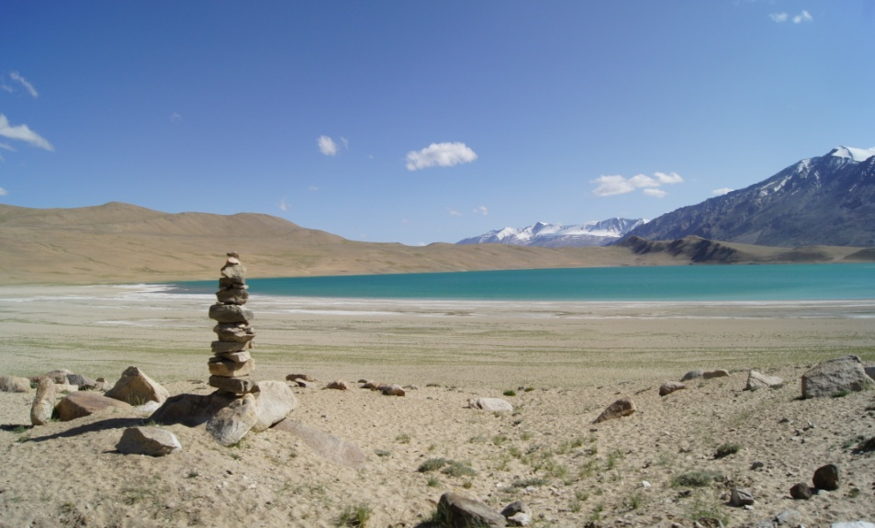
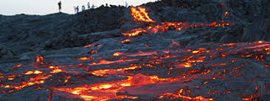
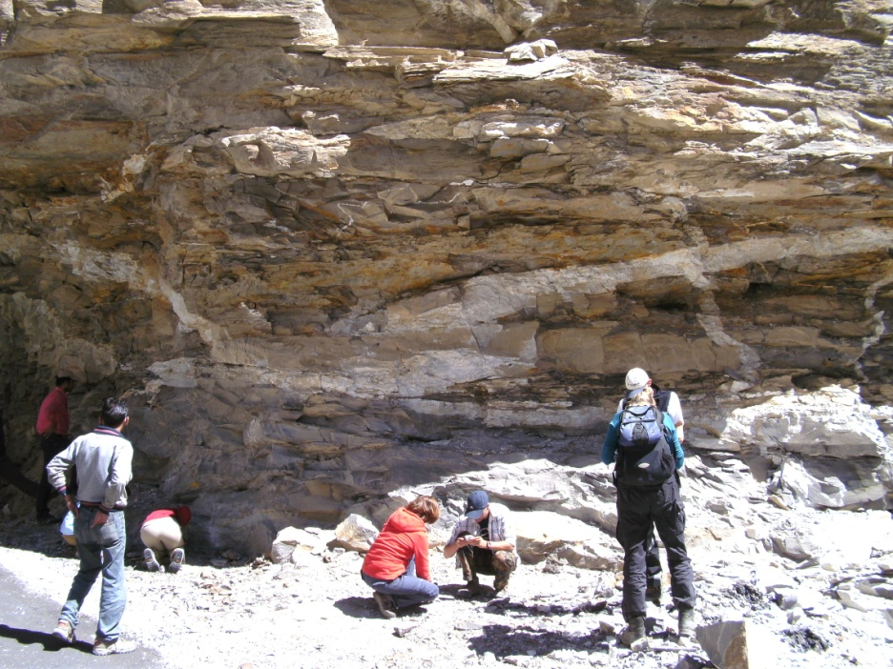
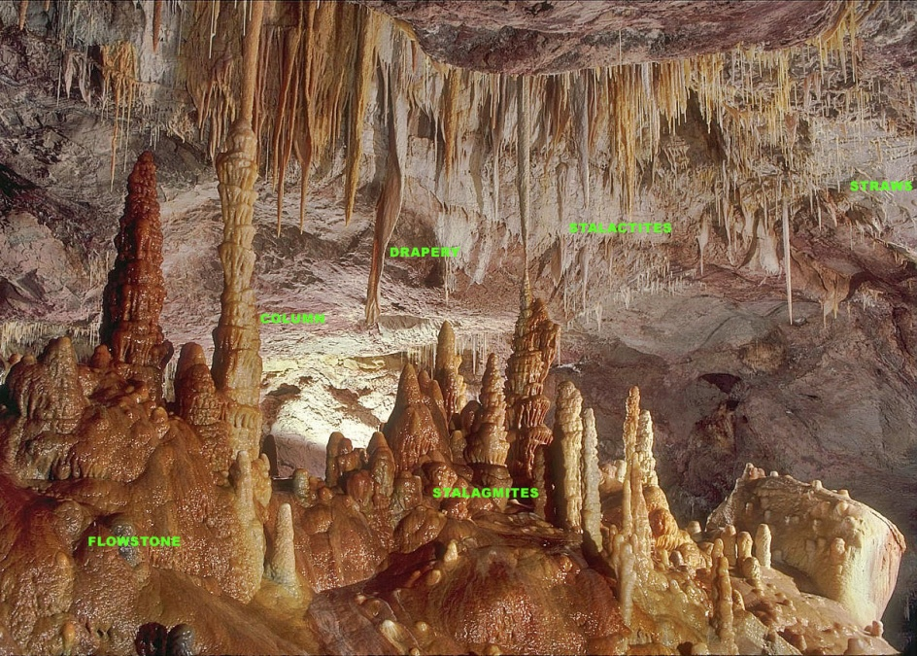
IDC203: IDC:203: Introduction to Earth Sciences

Slide 2
Convection currents
In 1960`s convection currents has been proposed as driving force to move continents
Notes:
\

Slide 3
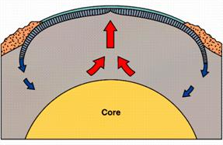
Convection currents
Driving force for convection?
Movement of matter is driven by Earth’s internal and external sources of energy

Slide 4
Convection currents

Slide 5
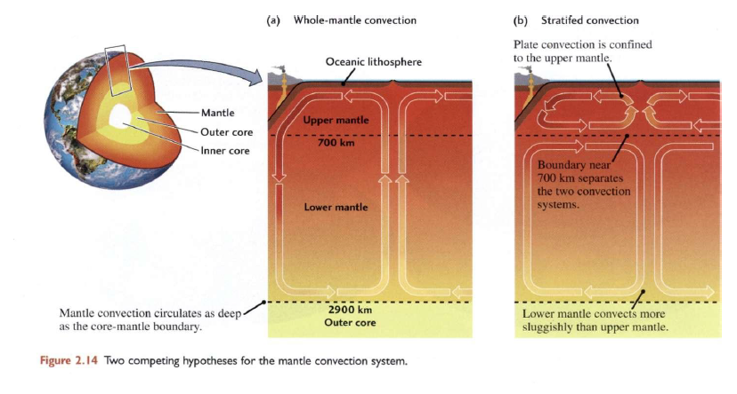
How deep does the convection occurs?
Two competing hypotheses for the mantle convection system

Slide 6
Rates and History of plate movements
How fast do plates move?
Do some plates move faster than others, and if so, why?
Is the velocity of plate movements today the same as it was in the
Geologic past?

Slide 7
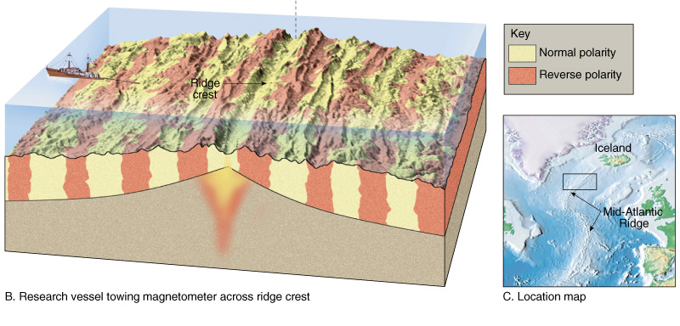
Rates and History of plate movements
Paleomagnetism

Slide 8
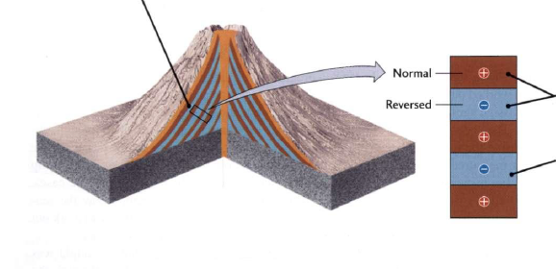
Paleomagnetism

Slide 9
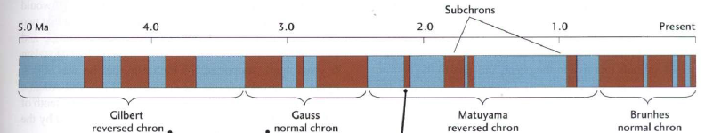
Paleomagnetism

Slide 10
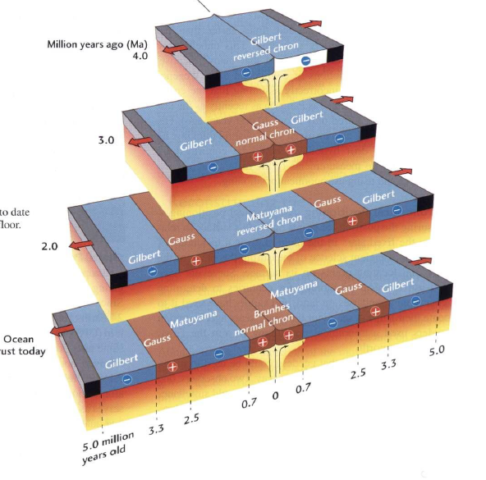
Paleomagnetism

Slide 11
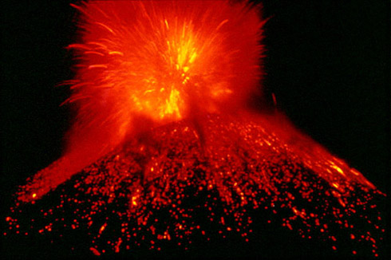
Volcanoes

Slide 12
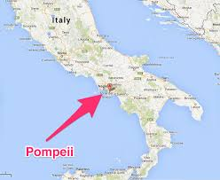
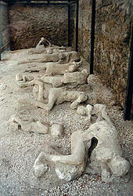
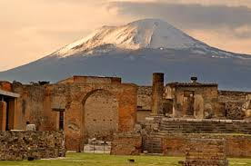
Eruption at Pompeii

Slide 13
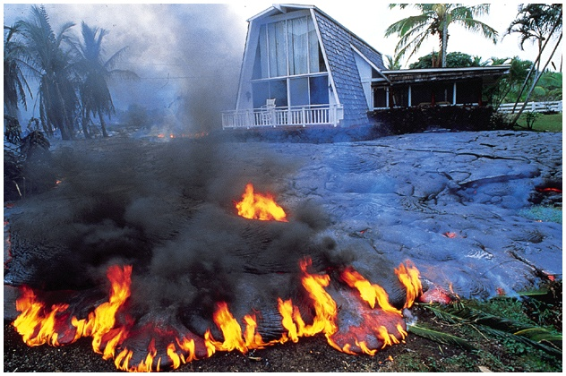
May 1990 Eruption of Kilauea, Hawaii
James Cachero/Sygma

Slide 14
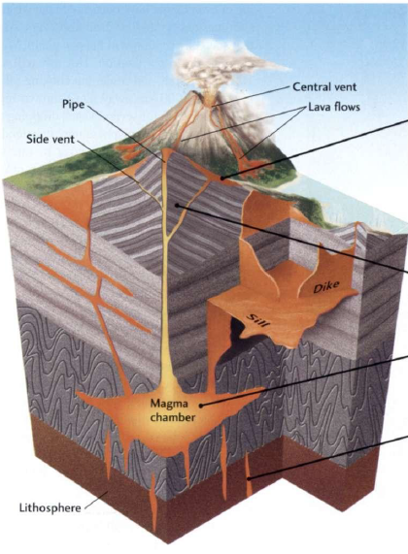
Plumbing System of a Volcano
Lava accumulates on the surface to form volcano
Lava erupts through a Central and side vents
Rise through the
lithosphere
Originates from the
Asthenosphere

Slide 15
Types of Lavas
Basaltic Lavas
Andesitic Lavas
Rhyolitic Lavas

Slide 16
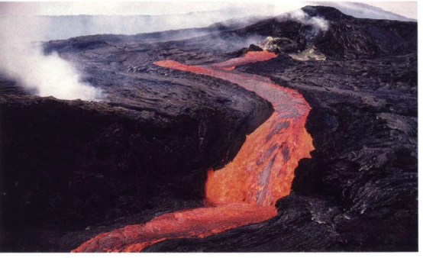
Basaltic Lavas
Mid oceanic ridges
Mafic in composition
Higher temperature
Rarely explosive
A central vent eruption from Kilauea, Hawaii produces fast flowing Basaltic lavas

Slide 17
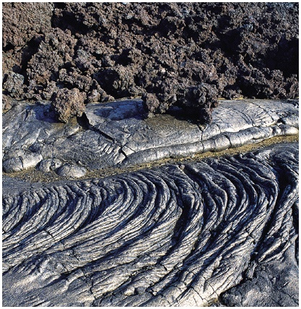
Type of Basaltic Lavas
Aa Lava
Pahoehoe Lava
Kim Heacox/DRX

Slide 18
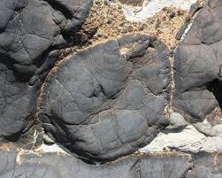
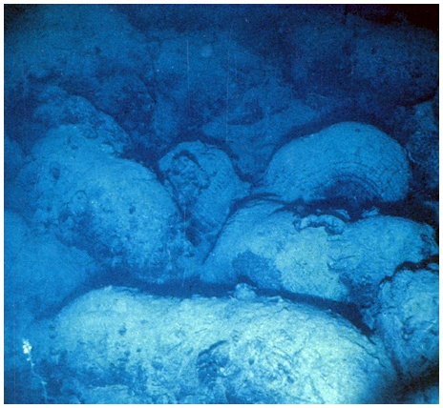
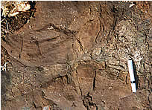
Pillow Lava
Woods Hole Oceanographic Institute

Slide 19
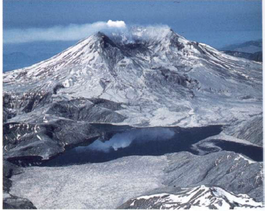
Andesitic Lavas
Intermediate SiO₂
Flow relatively slow
Temperature lower
Subduction settings
Phreatic explosions
Mount St Helens, a andesitic volcano in south-western Washington state

Slide 20
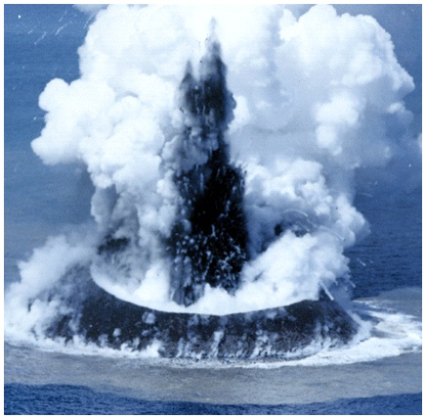
Phreatic explosions
Phreatic
Explosion
in the
Pacific
Maritime Safety Agency, Japan
Fig. 5.18

Slide 21
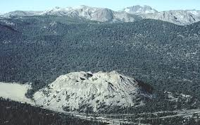
Rhyolitic Lavas
High silica (~68%)
Temperature lower (600-800)
Thick bulbous deposits
Gases are easily trapped with in ryholitic lavas
Viscous rhyolite lava flow. Wilson Butte dome, Long Valley, California

Slide 22
Types of magma
Magma Type | Solidified Rock | Chemical Composition | Temperature | Viscosity | Gas Content
Basaltic | Basalt | 45-55 SiO₂ %, high in Fe, Mg, Ca, low in K, Na | 1000 - 1200ºC | Low | Low
Andesitic | Andesite | 55-65 SiO₂ %, intermediate in Fe, Mg, Ca, Na, K | 800 - 1000ºC | Intermediate | Intermediate
Rhyolitic | Rhyolite | 65-75 SiO₂ %, low in Fe, Mg, Ca, high in K, Na | 650 - 800ºC | High | High

Slide 23
Textures of Volcanic rocks
Obsidian
Vesicular
Notes:
16

Slide 24
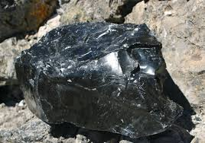
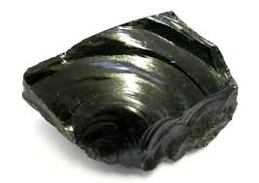
Obsidian
Silica rich rapidly cooled lavas form obsidian

Slide 25
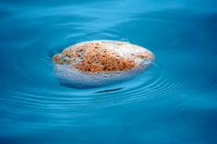
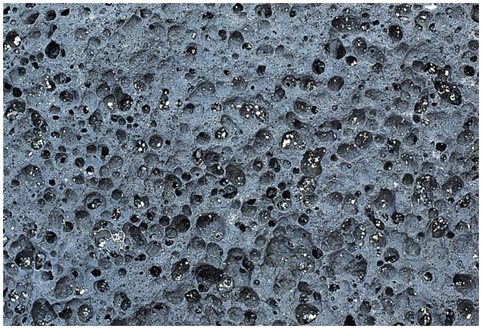
Vesicular Basalt
Pumice floating in water
Glen Oliver/Visuals Unlimited

Slide 26
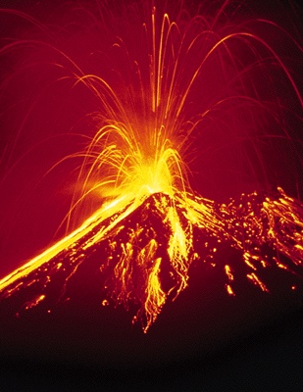
Pyroclastic deposits
Volcanic ejecta
Pyroclastic flows
Explosive eruption at Arenal Volcano, Costa Rica
Gregory G. Dimijian/Photo Researchers

Slide 27
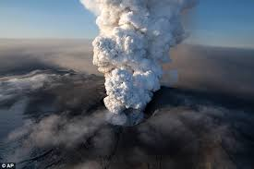
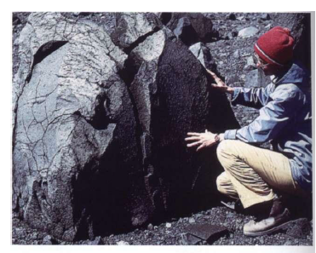
Pyroclastic deposits
Volcanic ash – less than 2mm in diameter
Volcanic Bombs- large fragments
Volcanic ash
Volcanic Bombs

Slide 28
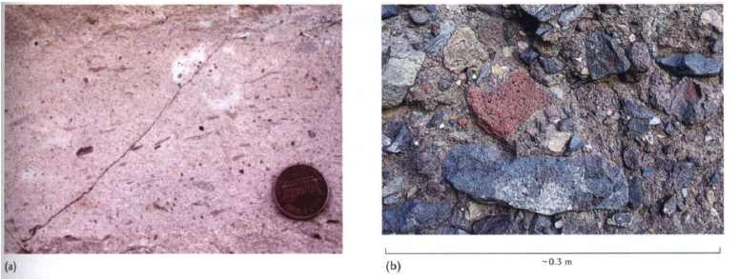
Pyroclastic deposits
Tuff
Volcanic breccia

Slide 29
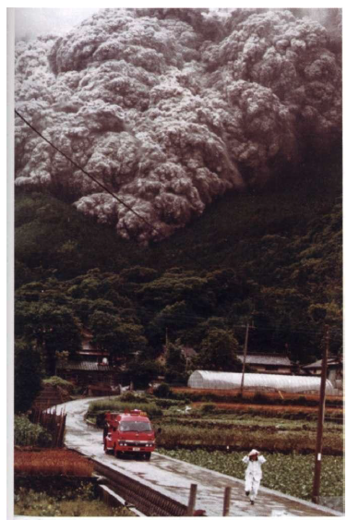
Pyroclastic flow
Pyroclastic flow plunged down the slopes of Mount Unzen, Japan

Slide 30
Eruptive styles and landforms
Composition of magma
- gas content
-chemical compostion
Type of material erupted (lava versus pyroclasts)
Environmental condition in which it erupts
(submarine vs. continental)

Slide 31
Central Eruptions
Shield Volcanoes
Low-viscosity lava flows (Mafic)
Gently sloping flanks — between 2 and 10 degrees
Notes:
11

Slide 32
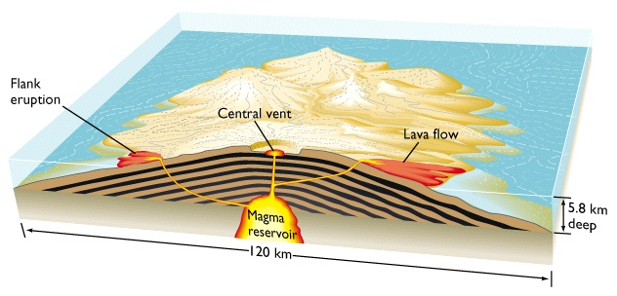
Shield Volcanoes

Slide 33
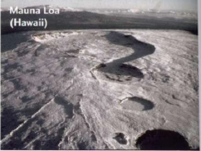
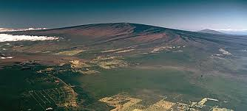
Shield Volcanoes

Slide 34
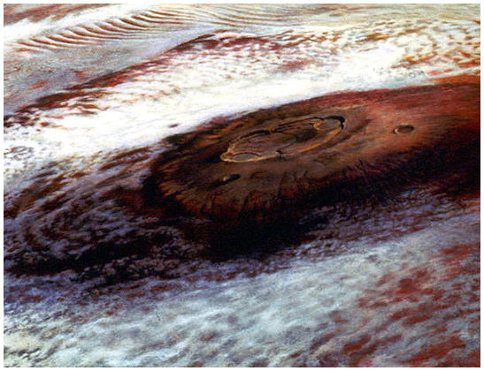
Olympus Mons Shield Volcano

Slide 35
Central Eruptions
Cinder Cones
Formed of pyroclastics only
Steep sides — ~30 degrees
Short duration of activity
Larger fragments near to vent form steep slopes
Notes:
12

Slide 36
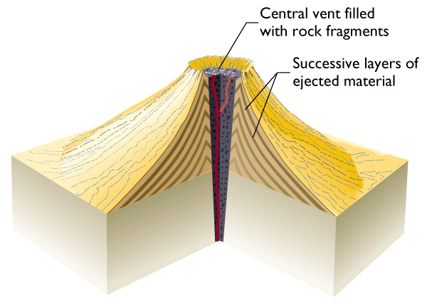
Cinder Cones

Slide 37
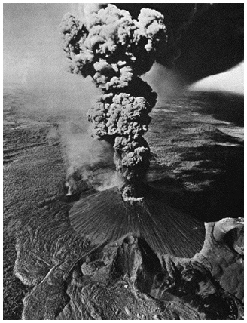
Cerro Negro Cinder
Cone near Managua
Nicaragua in 1968

Slide 38
Volcanic domes
Forms above a volcanic vent, a bulbous step sided mass of rock
Viscous lava — usually silica-rich (or cooler magma)
Associated with violent eruptions
Notes:
14

Slide 39
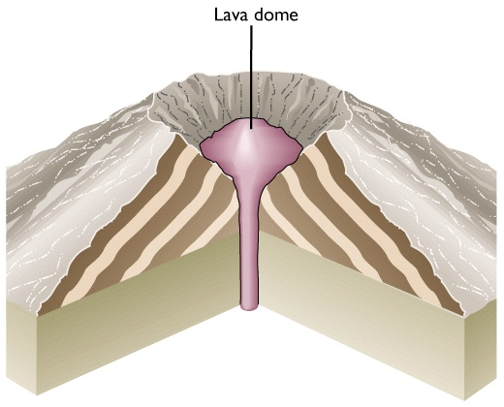

Slide 40
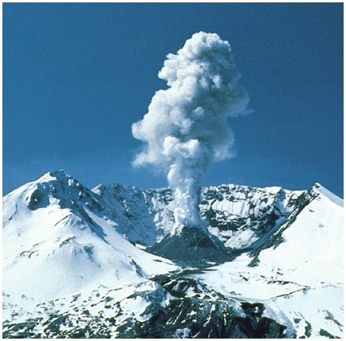
Lava
Dome
Fig.
5.11
Lyn Topinka/USGS

Slide 41
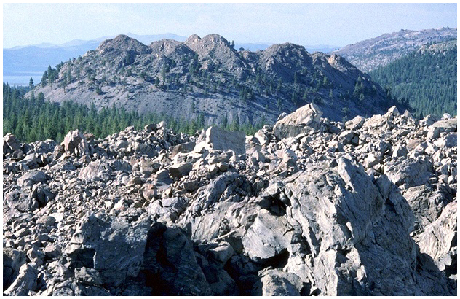
Inyo Obsidian Domes-California
P. L. Kresan

Slide 42
Composite/strato Volcano
Alternating pyroclastic layers and lava flows
Slopes intermediate in steepness
Intermittent eruptions over long time span
Mostly Andesite
Distribution
Circum-Pacific Belt (“Ring of Fire”)
Mediterranean Belt
Notes:
13

Slide 43
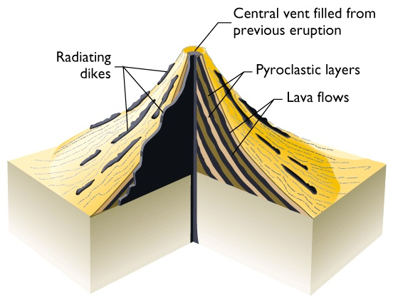
Composite Volcano

Slide 44
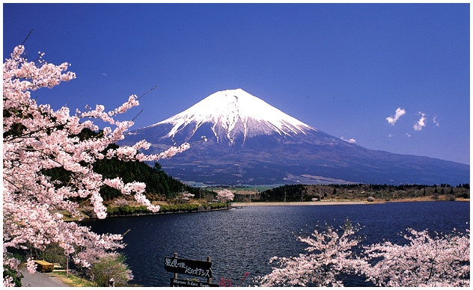
Mt Fujiyama, Japan
Fig. 5.15
Raga/The Stock Market

Slide 45
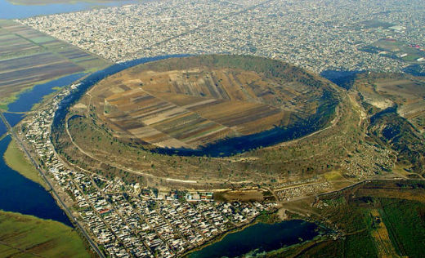
Crater
Bowl shape pit found at the summit of volcanic mountains
Xico volcanic crater, Mexico city

Slide 46
Calderas
Depression at top of volcano produced during an eruption
Great volume of magma are discharged rapidly from a large magma chamber, the chamber can no longer support it

Slide 47
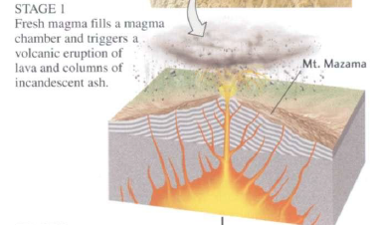
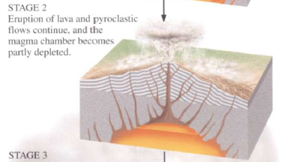
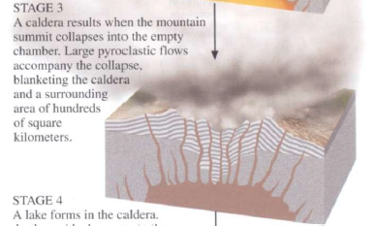
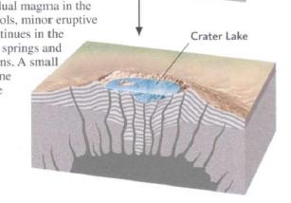
Calderas
Volcanic eruption
Magma chamber gets depleted
Collapse of mountain summit into empty chamber

Slide 48
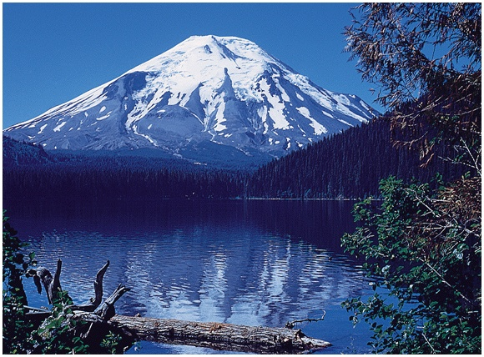
Mt Fujiyama, Japan
Before May, 1980
Emil Muench/Photo Researchers

Slide 49

After May, 1980
David Weintraub/Photo Researchers

Slide 50

Fissure type eruption

Slide 51

Fissure type eruption
Flood basalts
Deccan basalts

Slide 52

Fissure type eruption
Ash flow deposits
Quarry within pyroclastic deposits of Laacher See volcano, Germany

Slide 53
Materials ejected from Volcanoes
Volatile material
Steam (H₂O)
Carbon dioxide (CO₂ )
Hydrogen sulfide (H₂S)
Many other constituents (N, Ar, He etc)

Slide 54

Sulfur-encrusted fumerole:
Galapagos Islands
Christian Grzimek/Photo Researchers

Slide 55
The tectonic setting of Volcanoes
Convergent plate boundaries
Divergent plate boundaries
Within plate “hotspots”

Slide 56

The Volcanism associated with plate tectonics

Slide 57

The world`s active Volcanoes

Slide 58

Hotspots/Mantle plumes
Arises in the core mantle boundary
Large turbulent blob of hot materials- ‘plume head’
At top of the mantle the plume head generates large amount of magma
Speculative model for the formation of Hot spots

Slide 59
Effect of volcanoes on Human

Slide 60
Effect of Volcanoes on Human
Mineral deposits
Geothermal energy
Volcanic hazards
Effect on climate
Notes:
3

Slide 61


Hydrothermal deposits

Slide 62


Hydrothermal deposits
Black smokers
White smokers

Slide 63

Geothermal energy
Stokkur Geyser in
Iceland
Simon Fraser/Photo Researchers

Slide 64

Types of Volcanic Hazards

Slide 65
Types of Volcanic Hazards
Lava Flows: e.g. Hawaii, 1998
Gas: e.g. Lake Nyos (Cameroon), 1984
1700 people killed
Ash fall: e.g. Mt. Pinatubo, 1991
Pyroclastic flows: e.g. Mt. Pelee, 1902
28,000 killed
Tsunami: e.g. Krakatoa, 1883
36,417 killed
Lahars (mudflows): e.g. Nevado del Ruiz, 1985
23,000 killed

Slide 66
Volcanic mudflows (Lahar)
A mixture of water and pyroclastic material in a concrete-like slurry capable of moving up to 100 km/hour

Slide 67

Volcanic mudflows
23,000 killed in 1985 by volcanic mudflows, Nevada del Ruiz
Barbara and Robert Decker

Slide 68

Lava flows
Sanjuan, Mexico buried by Lava flows

Slide 69

Ash Fall
20th Century's 2nd Largest Volcanic Eruption - Mt Pinatubo-Eruption

Slide 70

Causalities associated with Volcanic Hazards since AD 1500

Slide 71


Effect on climate
In the year following the eruption, average Northern Hemisphere summer temperatures fell by as much as 1.2 °C (2.2 °F)

Slide 72
Predicting/controlling Eruptions
Instrumented monitoring can detect signals such as earthquakes, swelling of volcano and gas emissions that warn of impending eruptions
e.g., St Helens in 1980, Mount Pinatubo in the Philippines in 1991

